Slide 1

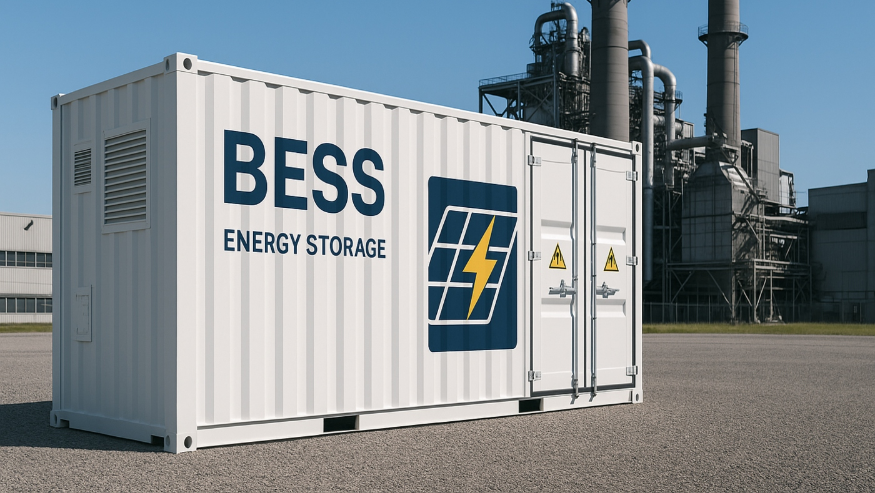



Session 4.3:
On-Site Solutions Deep Dive
Additional Considerations

Slide 2

About the Speaker
Cong Nguyen
Allotrope Partners
Vietnam Clean Energy Manager
Cong is a renewable energy professional with over a decade of experience. Prior to joining Allotrope, Cong cultivated extensive clean energy technical expertise by supporting the development of solar and wind farms, battery energy storage systems, and asset management projects. In his role with Allotrope, Cong supports corporate clients to evaluate and implement clean energy and decarbonization solutions across a range of technologies. This includes leading techno-economic assessments to determine costs and benefits for specific sites, managing projects and building stakeholder relationships, and supporting business development efforts in Vietnam. Cong holds a Bachelor’s degree in Electromechanics Maintenance Engineering from Hung Yen University of Technology and Education and has advanced certifications in renewable energy and reliability engineering.

Slide 3
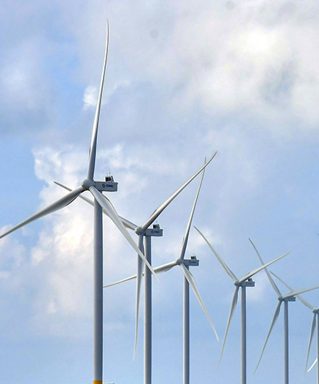
BESS Integration Strategy
Clean Energy Procurement Analysis & Optimization Framework

Slide 4
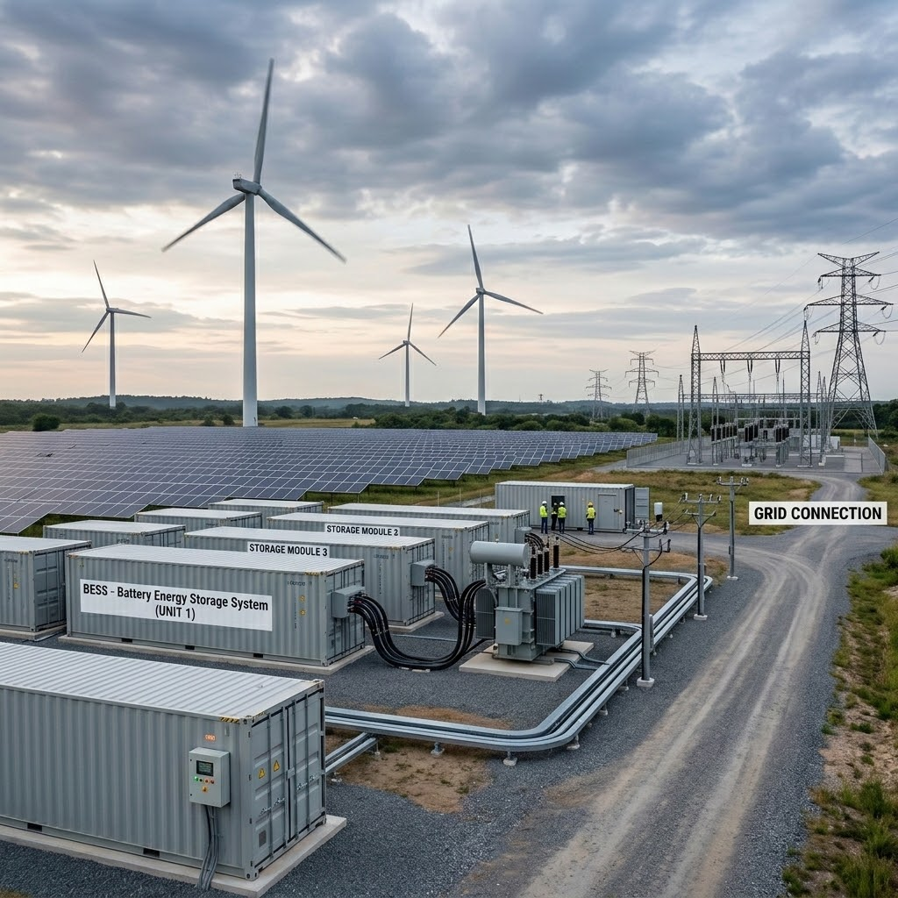
The New Energy Era
Vietnam's energy market is undergoing a complex structural transition, ending the era of fixed, subsidized grid electricity.
Average retail electricity prices have increased by over 17% in the past three years.
The cross-subsidy mechanism for production is being phased out, which directly threatens corporate profit margins.
Battery Energy Storage Systems (BESS) are now foundational for managing electricity price risks and meeting stringent international decarbonization standards.

Slide 5
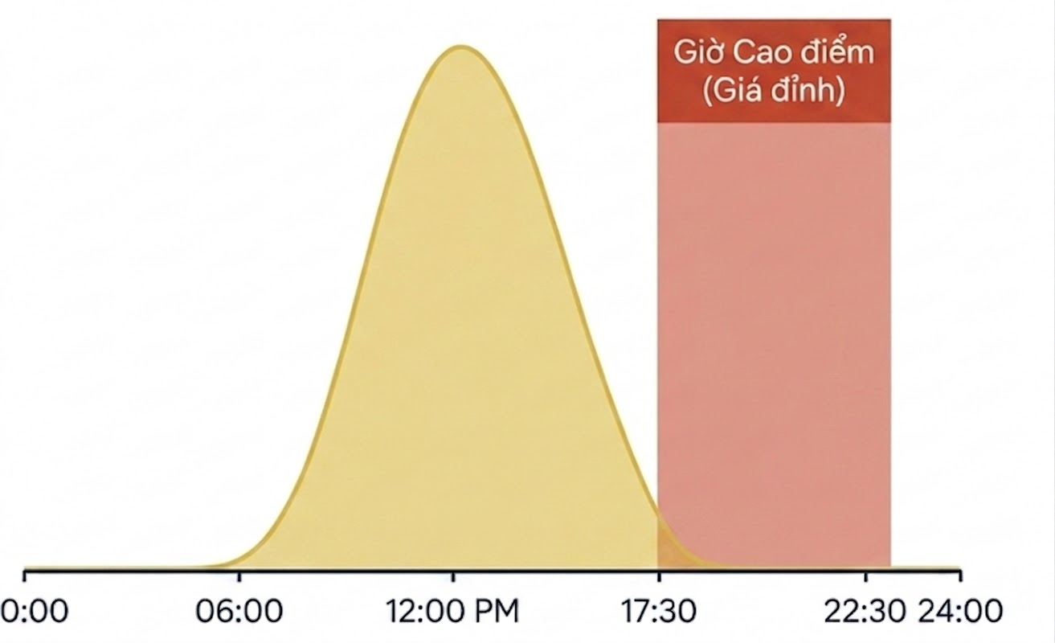
Cost Shock: TOU Tariff Updates (QĐ963)
Comparison Criteria | Old TOU Mechanism (Pre-2026) | New Mechanism (Decision 963, 2026)
Morning Peak Window | 09:30 – 11:30 (matches solar generation peak) | Completely eliminated
Evening Peak Window | Fragmented structure, short duration | 17:30 – 22:30 (5 continuous hours)
Standalone Solar | High profit by cutting morning peak costs | Dropping IRR, only offsets normal prices
BESS in Production | Optional auxiliary for price arbitrage | Mandatory to offset evening prices & restore IRR
Peak Hour (Peak Price)

Slide 6
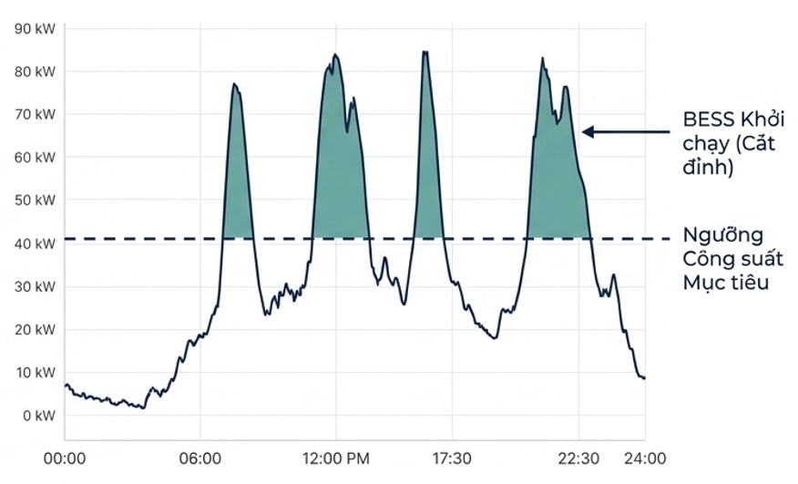
Two-Part Electricity Pricing Risks
Spiky Load Profile
The new pilot pricing mechanism separates the bill into an Energy Charge (kWh) and a Maximum Capacity Charge (kW).
The system records the highest demand peak in every 30-minute cycle of the month.
Factories with equipment consuming large instantaneous power (welding, smelting, pressing) will face massive capacity penalties, causing total bills to skyrocket.
BESS Activation (Peak Shaving)
Target Capacity Threshold
Peak Shaving Strategy
Integrating an Energy Management System (EMS) and BESS is the defensive measure.
BESS detects impending capacity thresholds and automatically discharges to intervene.
Shaving the grid power draw profile helps factories avoid expensive, fixed monthly capacity penalties.

Slide 7
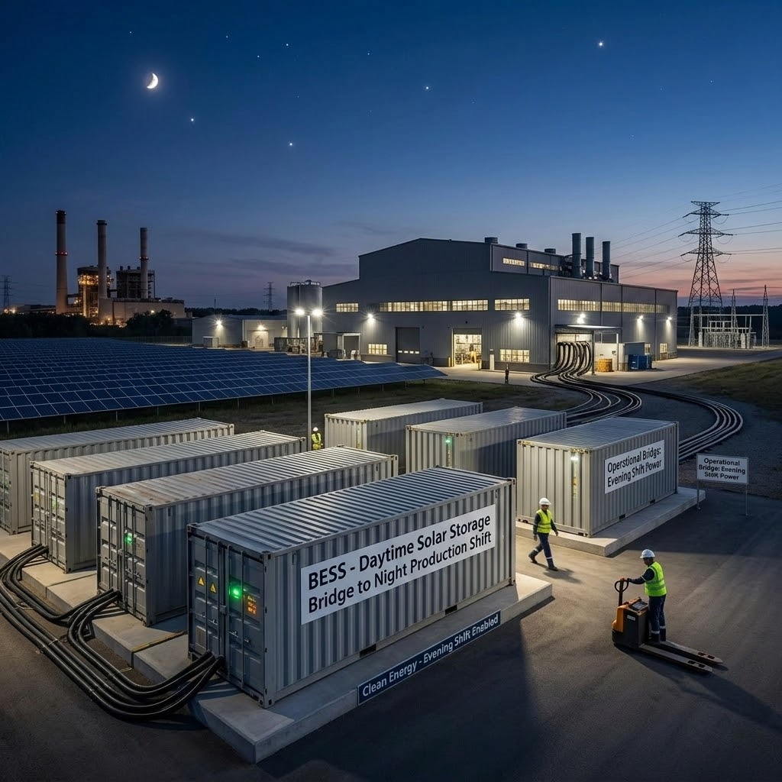
CFE Energy Standards
Beyond “Volumetric Matching”
Most RE100 members (e.g., LEGO, H&M) now prioritize additional, project-based procurement
Shift from unbundled, paper-only REC to PPAs/DPPAs.
Direct connection to new renewable energy project
BESS is a key technological bridge to solve the nighttime emissions gap by storing daytime solar energy to power evening production shifts
BESS SOLVING THE GAP

Slide 8

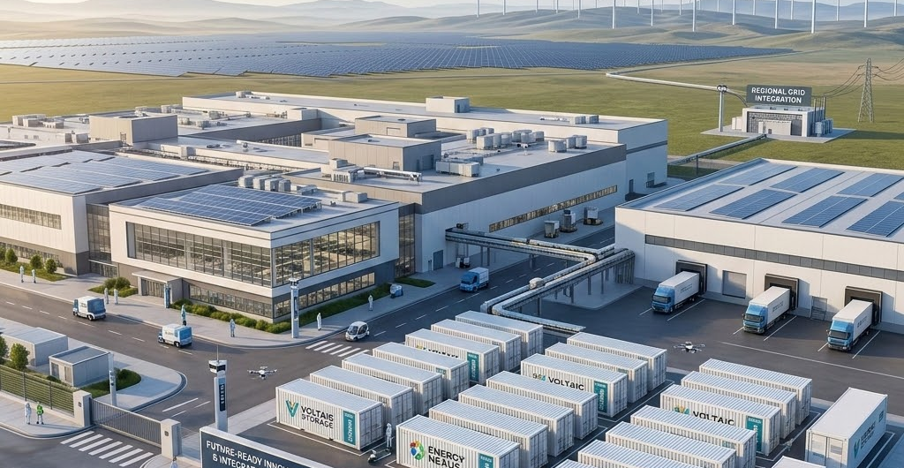
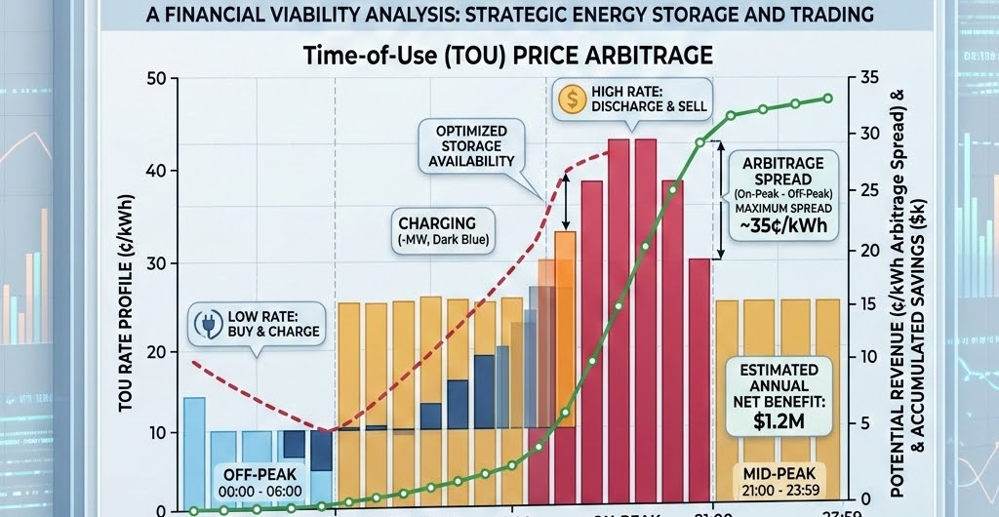
Value Stacking Equation
Capacity Management
Increase Daily RE Consumption
TOU Price Arbitrage
The largest revenue stream comes from automatic “peak shaving”, completely eliminating expensive capacity charges from the two-part mechanism.
Maximizes the lifecycle of rooftop solar, raising the renewable energy self-consumption rate from 40% to well over 70%.
Stores power during off-peak windows and discharges during the 5-hour evening peak, fully leveraging electricity price arbitrage.

Slide 9




Supportive Regulatory Framework (2025–2026)
Electricity License Exemption (Decree 61): Proposes complete exemption of generation licenses for BESS under 3 MW, removing the biggest administrative bottleneck and enabling ultra-fast deployment of Behind-The-Meter (BTM) systems.
Loosened Export Caps (Decree 58): Raises the ceiling for selling excess rooftop solar up to 50% of actual generation, providing a safety net for oversized systems during holidays and weekends.
Peer-to-Peer Trading (DPPA): Paves the way for industrial parks to establish micro-grids, letting enterprises sell excess solar energy to partners within the same network.
Specialized National Standards (TCVN): Over 15 new National Standards issued in sync with IEC 62619, resolving barriers related to fire safety and bank credit requirements.

Slide 10
VPPA & Load Profile Risks
Profile Risk: If company consumes a lot of power during the evening (paying high retail rates because there is no solar) but doesn't use enough at noon (when solar power peaks and market prices crash), the factory will suffer a "double loss" → Pay expensive retail prices to EVN and pay out-of-pocket to cover the CfD losses to the generator.
Curtailment Risk: When the grid is congested, generation is curtailed by the NSMO. This mismatch forces the buyer to purchase 100% of their load at standard retail prices from EVN, causing a shortage of bundled Renewable Energy Certificates (RECs).
BESS - The Firming Solution:
Increased Matching Rate: Co-located BESS discharges during the evening peak, significantly increasing the temporal alignment between RE generation and the buyer's 24/7 load profile.
Offtake Commitment Security: Enables the buyer to fulfill minimum offtake commitments under the PPA by capturing excess midday energy that would otherwise be curtailed or sold at zero value.
Enhanced Bankability: Transforms a variable VPPA into a "Firmed Product," increasing the contract's credit and making green financing disbursement significantly easier.

Slide 11
Enhancing Bankability
Bankability Through “Firmed PPA”
100%
Offtakers accept paying a premium for the BESS firming cost. In return, they receive a VPPA contract immune to weather conditions and spot-market volatility.
Stable payment cash flows and highly predictable long-term costs make BESS-integrated VPPAs a “gold standard” asset, making green credit disbursement significantly easier.
Elimination of
Merchant-Tail Risk

Slide 12
Implementation Roadmap
Assess whether the plant has a flat or fluctuating load to calculate the required BESS capacity and optimize Peak Shaving, Energy Arbitrage, and Demand Matching strategies.
Negotiate large-scale Firmed VPPAs, or participate in Aggregation alliances at the Industrial Park.
Step 1: Measurement
Step 2: Load Profile Analysis
Step 3: Integration
Step 4: Expansion
Smart Profiling evaluation. Identify 30-minute capacity fee risks under the new pricing mechanism.
Invest in BTM BESS and EMS system for smart energy management, elevating to 24/7 CFE standards.

Slide 13
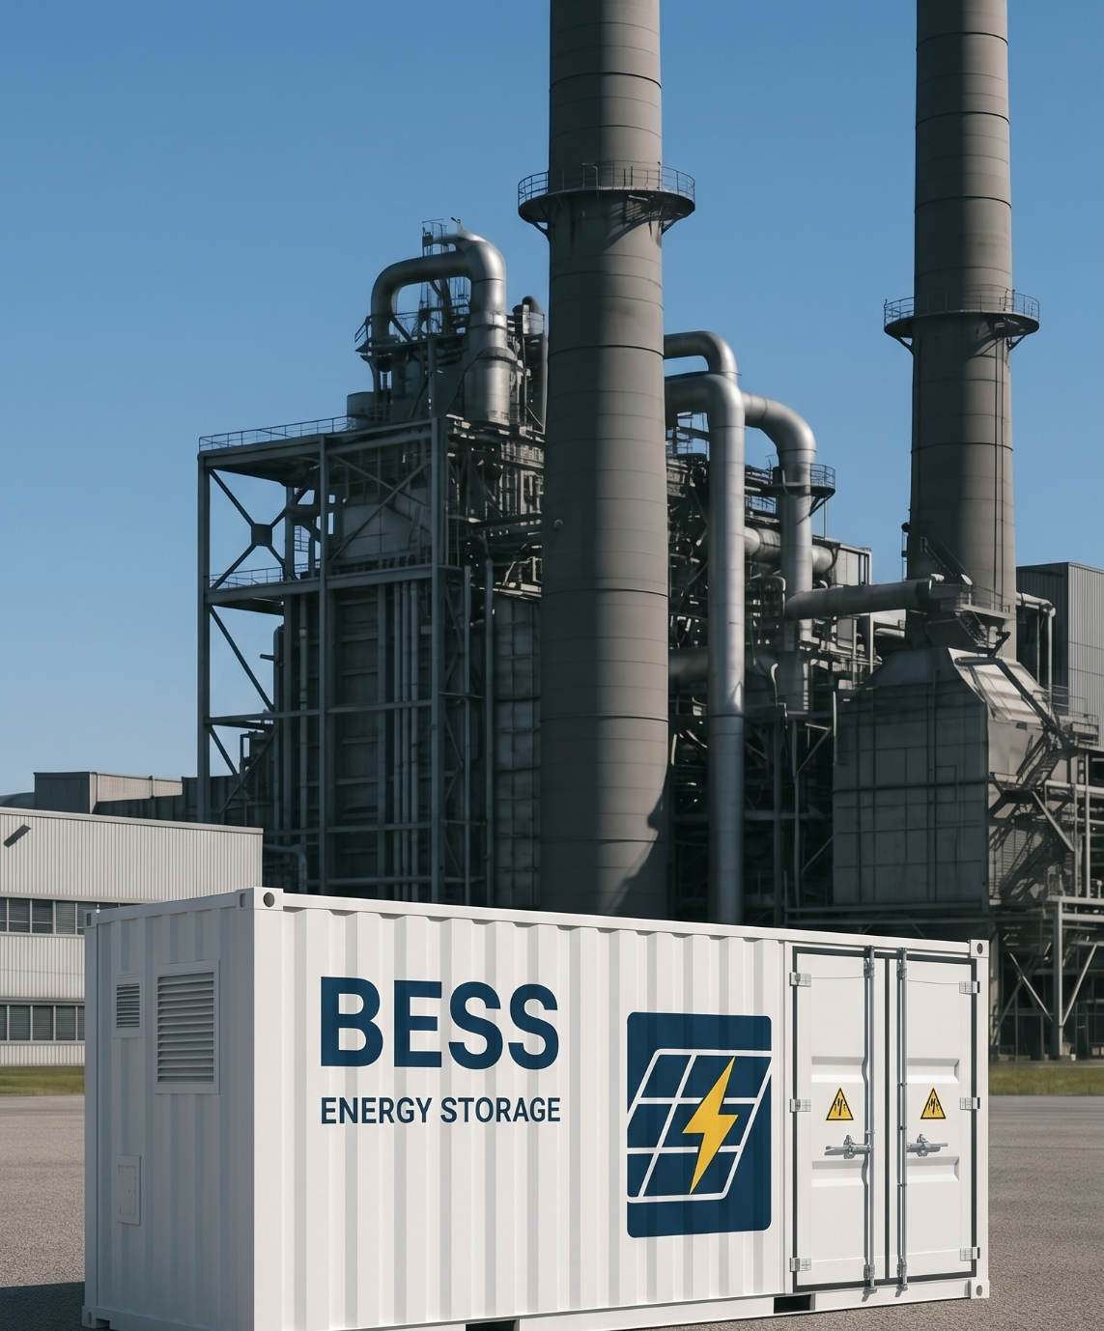

Factory A case study
BESS turns rooftop solar from a tariff hedge into a flexible clean-energy asset.

Slide 14
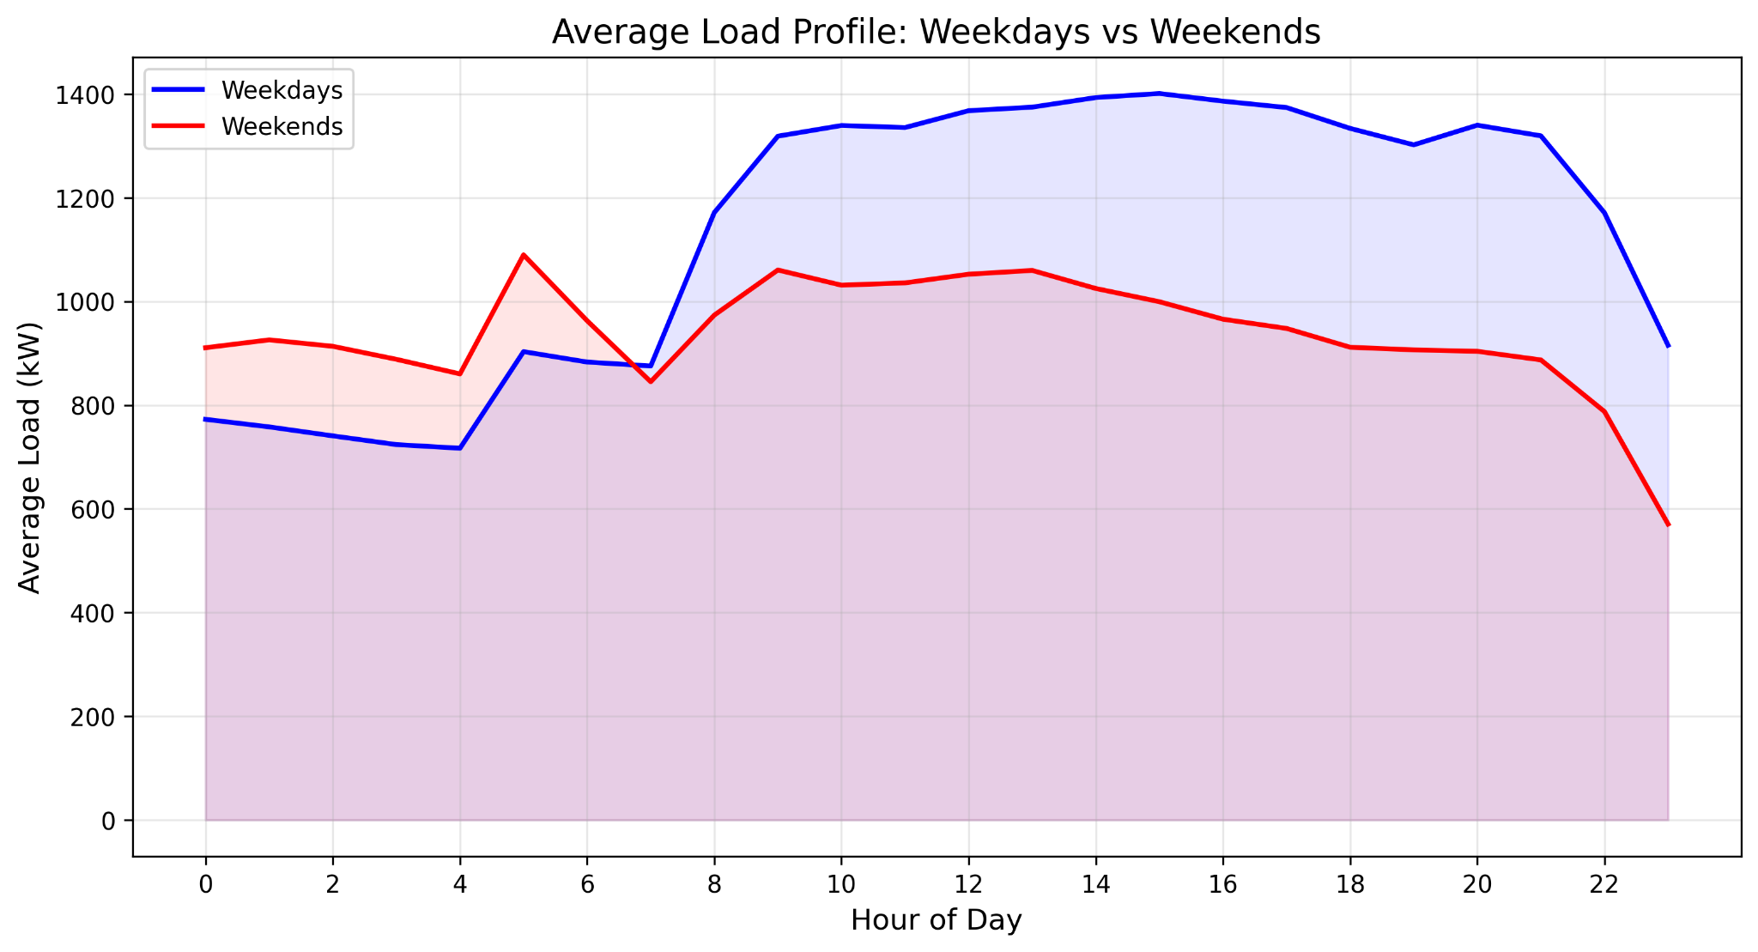
One Factory, Four Procurement Strategies
Metric | Value
Annual electricity consumption | ≈ 9,750 MWh (~9.75 GWh)
Peak capacity | ≈ 2,430 kW (2.4 MW)
Average capacity | ≈ 1,110 kW
Nighttime baseload capacity | ≈ 900 kW
Load Factor | 0.46
Operating mode | Almost 24/7, continuous year-round
% daytime consumption (6 AM – 6 PM) | ≈ 54%
% nighttime consumption | ≈ 46%
Monthly consumption | Fairly consistent, ~690–860 MWh/month
FOUR SCENARIOS — EACH INDEPENDENTLY SIZE-OPTIMIZED
CASE 4
CASE 1
Solar Only
Solar + BESS
New TOU (Decision 963). PV only - no storage. The conventional rooftop benchmark.
Today's tariff (current TOU). Integrated PV + battery, the baseline integrated system.
CASE 2
CASE 3
Solar + BESS
Solar + BESS
New evening-peak TOU (Decision 963, 17:30–22:30). Integrated PV + battery.
New TOU + two-component capacity tariff (~209,459 VND/kW/mo). PV + battery.
• 70% debt, 8.5% interest, 10-year tenor, 10% owner discount rate
• 25-year ESCO cash flow, USD-facing workbook outputs
• BESS grid charging disabled in all four cases
• ESCO energy price = 90% of EVN time-specific energy tariff
Factory A, Vietnam, 22-110kV tariff, 2025 load profile

Slide 15
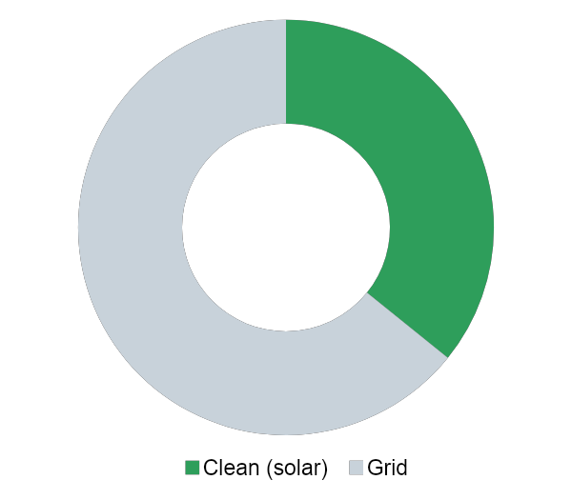
Solar Alone Stalls at One-Third of Demand
Even fully optimized, a solar-only system meets only 36% of the factory's load.
Why it plateaus
Under Decision 963 the priced peak shifts to 17:30 - 22:30 after sunset. Daytime panels offset only midday consumption.
The expensive evening peak stays on full price grid power.
Adding more panels doesn't help: past ~36% of load, midday surplus is curtailed or exported at low value, so the optimizer stops at 3.45 MW.
It is a partial daytime hedge, not a path to 24/7 clean energy.
Optimal system: 3.45 MW PV, no storage
36%
Clean self-supply
$245k
Annual bill savings
18.7%
Equity IRR
$0.80M
25-year NPV

Slide 16
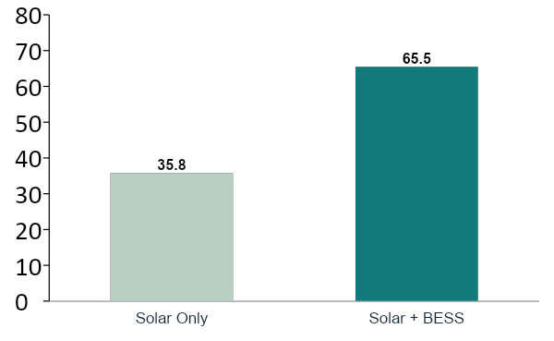
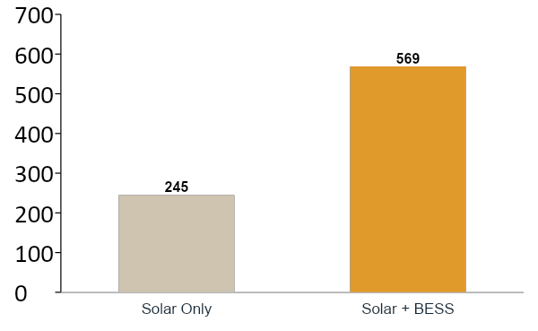
Storage Nearly Doubles Clean Supply and Savings
Same factory, same new tariff - add a battery (Case 4 → Case 2):
CLEAN SELF-SUPPLY (% of load)
ANNUAL BILL SAVINGS (USD)
+30 points clean energy, +$324k/yr savings, package still earns 16% equity IRR with $1.44M NPV
The battery shifts midday solar into the evening peak, turning a daytime hedge into round-the-clock clean supply.

Slide 17
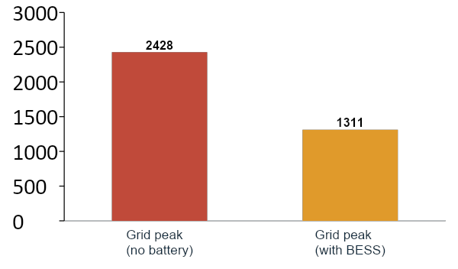
The 2026 Capacity Tariff Makes Peak-Shaving the Prize
When EVN starts billing capacity (~209,459 VND/kW/month), the dominant value flips from energy arbitrage to demand charge avoidance.
The optimizer adds battery power to cut the grid peak nearly in half:
2,428 kW → 1,311 kW (−46%)
Returns tighten as the system grows, but every metric stays bankable, and this is the tariff Factory A will actually face in 2026.
PEAK GRID DEMAND - CASE 3
$129k
Demand-charge savings / yr
-65%
Total bill ($758k → $263k)
12.4%
Equity IRR (still bankable)
1.01
Avg DSCR (debt-serviceable)

Slide 18
Full Techno-Economic Comparison
 | Solar Only | Solar + BESS | Solar + BESS | Solar + BESS
Tariff regime | New TOU 963 | Current TOU | New TOU 963 | TOU 963 + 2-comp.
PV size | 3.45 MW | 5.32 MW | 5.91 MW | 5.77 MW
Battery (power / energy) | - | 1.66 / 8.3 | 1.80 / 10.7 | 1.83 / 11.7
Clean self-supply | 35.8% | 59.5% | 65.5% | 65.8%
Total CapEx | $1.66M | $3.68M | $4.27M | $4.32M
Annual bill savings | $245k | $531k | $569k | $494k
Equity IRR | 18.7% | 18.2% | 16.1% | 12.4%
25-year NPV | $0.80M | $1.65M | $1.44M | $0.59M
Average DSCR | 1.33 | 1.31 | 1.21 | 1.01
Simple payback | 9.0 yr | 9.4 yr | 10.5 yr | 12.2 yr
READING THE TABLE
All four are NPV-positive and clear DSCR ≥ 1.0 - every option is financeable.
Adding BESS lifts clean supply from 36% to ~60-66%.
Tariff reform compresses returns (18% → 12%) but never breaks bankability.
Solar-only has the highest IRR but the lowest absolute value and clean share.

Slide 19
What the Four Cases Tell Us
01
Solar alone is only a partial hedge
RECOMMENDATION
Optimized rooftop PV caps at ~36% of demand and leaves the priced evening peak on the grid.
Pursue integrated Solar + BESS now, and size storage to the tariff you will face in 2026, not the one you have today.
02
BESS is what unlocks 24/7 clean energy
Storage lifts clean self-supply to 60 - 66% and roughly doubles bill savings, while equity IRR stays 16-18% and NPV stays positive.
03
Tariff reform compresses but never breaks the case
Across current TOU, Decision 963 and the two-component tariff, every Solar+BESS case clears DSCR ≥ 1.0 and remains financeable.
The battery converts a daytime solar hedge into bankable, round-the-clock clean supply.
04
Size the battery for the 2026 tariff, not today's
Under the two-component capacity charge, demand-charge avoidance (peak −46%) becomes the single largest value stream. Size for power, not just energy.

